Slide 1
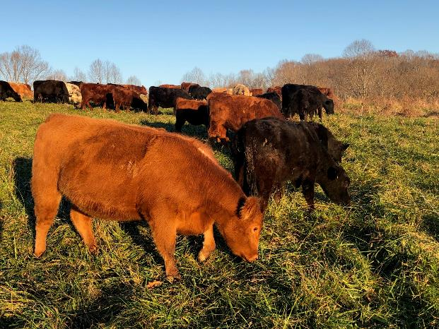
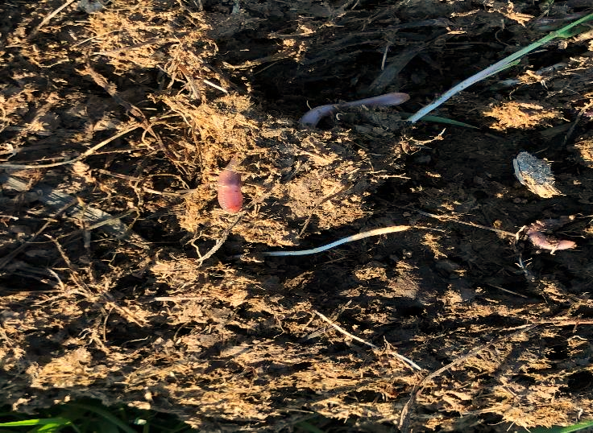
Module 4
Determining Levels of Biological Function
Soil Health Resource Concerns
What is the role of livestock?
What are desired ratios? C:N, Fungal:Bacterial
Levels of soil biological function comparing:
  Continuously grazed systems
  Adaptively managed grazed systems
  Silvo-pasture
Assessment Tools
Notes:
When the quantity, quality, diversity, or connectivity of food, cover, space, shelter, and/or water is inadequate to meet the requirements of beneficial soil organisms.

Slide 2
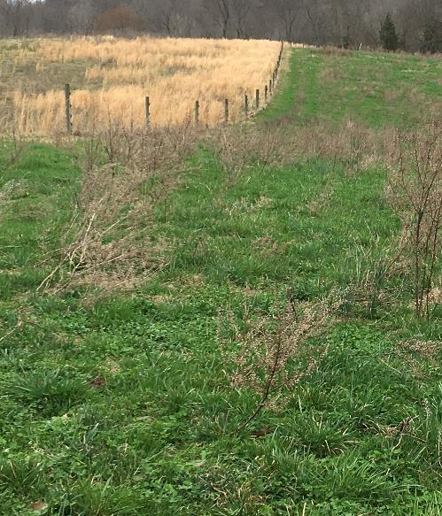
The Goal of Soil Biology Management, Improve Habitat
How management practices and disturbances impact soil biological functions
Microbial habitat: Enhanced (E) or
Degraded (D)
  Managed Grazing (E)
  Overgrazed/Severe grazed(D)
  Feeding hay strategically (E)
  Feeding in one site (D)
Food sources: Added or removed
  Monoculture (D)
  Diversity (E)
  Canopy and residue management (E)
Soil organisms: Directly added or killed
  Persistent broad action pesticides (D)
  Chronic disturbance (D)
  Canopy and residue management (E)
Notes:
Picture of continuous grazing on the left side of the fence and adaptive rotational grazing management on the right. 1 )Microbial habitat is enhanced when plant cover, roots, biodiversity and disturbance are managed. Bare ground has the biggest impact on microbial habitat. Feeding hay strategically involves placing hay typically by unrolling or moving hay feeding site with each feeding. Placement of the hay would be where soil nutrients are low and where the plant community is undesirable. 2) Food Sources are improved by biodiversity due where the type and supply of food is available over a longer period of time. 3) Soil organisms benefit from a stable habitat.

Slide 3
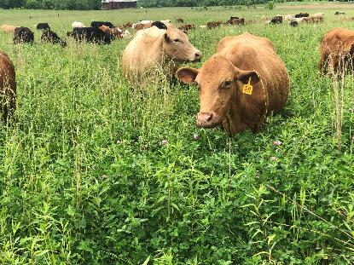
Comparing Different Methods of Grazing
Plant cover, soil residue, plant diversity, roots, soil life, darker soil color, and reduced soil compaction.
Continuous overgrazed-Aggregate Instability, Organic Matter Depletion, Soil Organism Habitat Loss or Decline, Compaction), (SSS, HF, BI)
  Low density of animals
  Low plant cover (spot grazing)
  Low residue cover
  Plant diversity?
  Roots low
  Soil life low
  Soil color lighter
  Poor Fecal distribution
  Higher soil bulk density
  High supplemental feed needs
  High evaporation
  Low carrying capacity
Adaptive Grazing and Silvopasture
(meets assessment criteria)
  High density of animals
  High plant cover
  High residue cover
  Plant diversity can be reduced
  Roots high
  Soil life high
  Soil color darker
  Good Fecal distribution
  Lower bulk density
  Low supplemental feed needs
  Elevated carrying capacity
Notes:
Picture of cattle grazing a diverse pasture of grass, clover and forbs. In general it is good to keep forage height at nose height of the animal for begin grazing height. Continuous overgrazed land can impact all soil health resource concerns. Adaptive grazing improves habitat for soil life. Comparison data information adapted from Frank et al., 1998;Teague et al., 2013; Jakoby et al., 2015;Savory and Butterfield, 2016; Park et al., 2017; Stanley et al., 2018; Dowhower et al. 2019; Pecenka and Lundgren, 2019.)

Slide 4
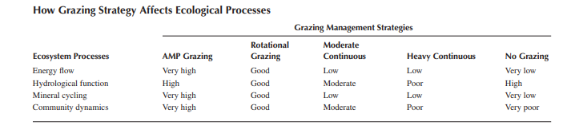
Adaptive Multi-paddock
Notes:
Source: Holistic Management, A New Framework for decision making; Alan Savory and Jody Butterfield. Determining Indicators of Pastureland Health is an assessment guide to determine ecological function.

Slide 5
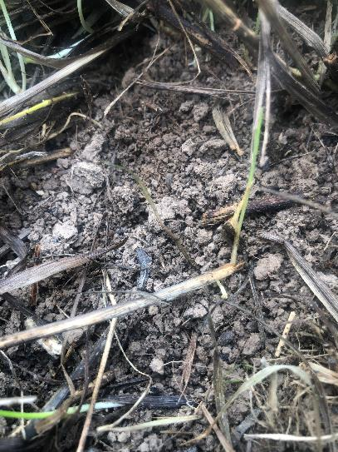
Functions of the soil food web
(Plants are the primary producers)
Soil organisms improve
  aggregate stability
  water infiltration
  moisture storage and availability
  nutrient storage and availability, and
  buffering the impacts of excess pesticides, nutrients, climate, and pathogens
  reducing runoff, flooding, and erosion
Notes:
Functions of the soil food web
Soil organisms improve aggregate stability, improving water infiltration, moisture and nutrient storage and availability, and buffering the impacts of excess pesticides, nutrients, and pathogens, and reducing runoff, flooding, and erosion. Healthy soil creates resiliency of vegetative cover.
Without the soil food web, the remains of dead plants and animals would accumulate on the earth's surface, making nutrients unavailable to plants. Soil biota decomposes these organic residues and some forms of organic matter in the soil. They convert these materials into new forms of organic matter and release carbon dioxide into the air.
Picture of good surface soil aggregates under good grass cover.

Slide 6
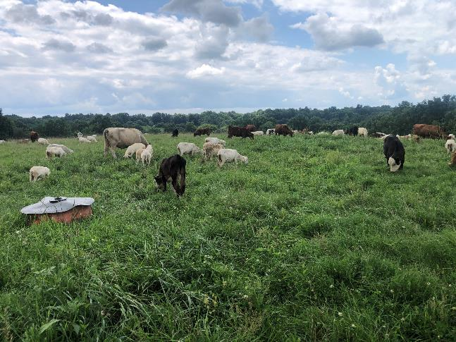
Why Should Land Managers Understand Soil Biology?
Reducing the need for additional inputs
  Fertilizer
  Pesticides
  Irrigation
More stable production
Healthy soil creates resiliency
Notes:
The effective functioning of the soil food web is integral for the efficient flow of energy in the form of carbohydrates as feed and carbon to feed soil life increasing organic matter which ultimately improves nutrient cycling and nutrient availability as well as increasing water holding capacity of soils and purifying water. Similar to perpetual motion, as long as the biologic habitat is maintained the system functions.
Picture of vegetative grass and clover with cattle and sheep grazing.

Slide 7
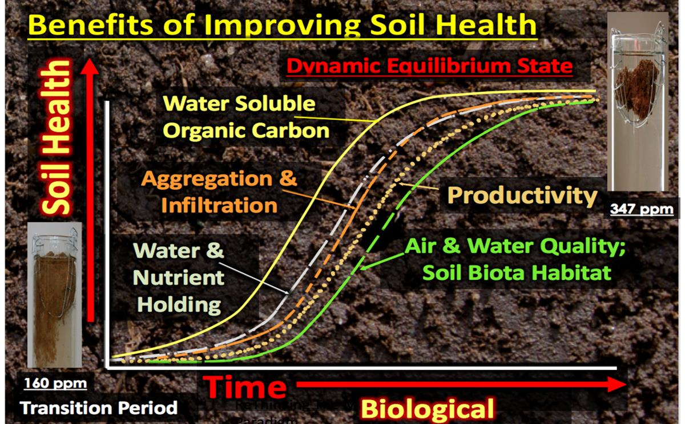
WSOC
WSOC
Notes:
In this example 160 ppm Water Soluble Organic Carbon (WSOC) in conventional managed soil compared to a healthy soil having 347 ppm WSOC. As WSOC increases aggregation and infiltration, water and nutrient holding capability, air and water quality along with soil biota habitat, and productivity improve through time. Pictured are slake test cylinders on the left instable poorly managed soil, on the right water stable soil aggregates managed for soil health. Dynamic equilibrium state is when soils have reached a state where soil health functions stable even though individual components within it are constantly changing. To achieve improved soil health a disruption may need to occur. Example would be a longer plant recovery and increased root growth, higher density-short duration grazing, laying more plant residue in touch with the soil, increasing plant diversity,

Slide 8
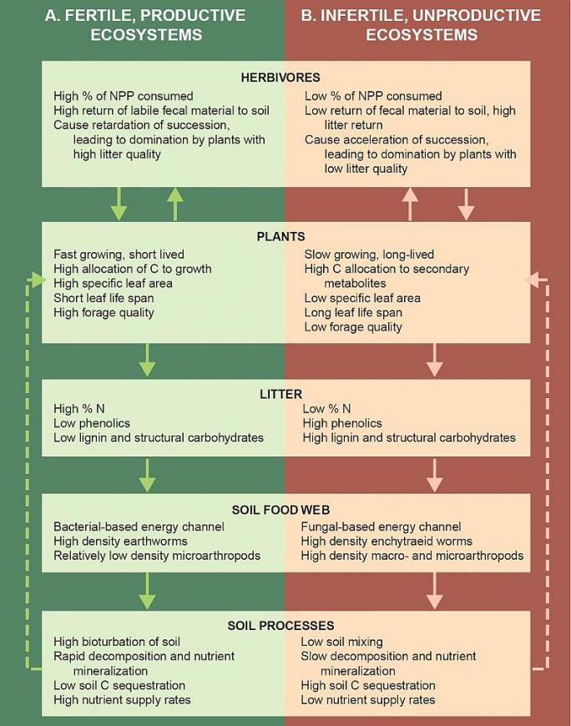
NPP- Net primary production is the production less respiration of the plant
Notes:
One major ecological driver is the difference in fundamental plant traits between species that dominate (A) fertile systems that support high herbivory and (B) infertile habitats that support low herbivory. Net primary production (NPP) is the sum of gross primary production less the respiration of the plant. Plant traits serve as determinants of the quality and quantity of resources that enter the soil and the key ecological processes in the decomposer subsystem driven by the soil biota. These linkages between belowground and aboveground systems feedback (dotted line) to the plant community positively in fertile conditions (A) and negatively in infertile ecosystems (B). Litter phenolics can act as antioxidants, lignin, flavonoids and tannins. Soil Food Web enchytraeid worms are small clear earthworms sometimes called pot worms. Soil processes, bioturbation is the movement of soil by animals and plant roots.
Source: Wardle et al. (2004)

Slide 9
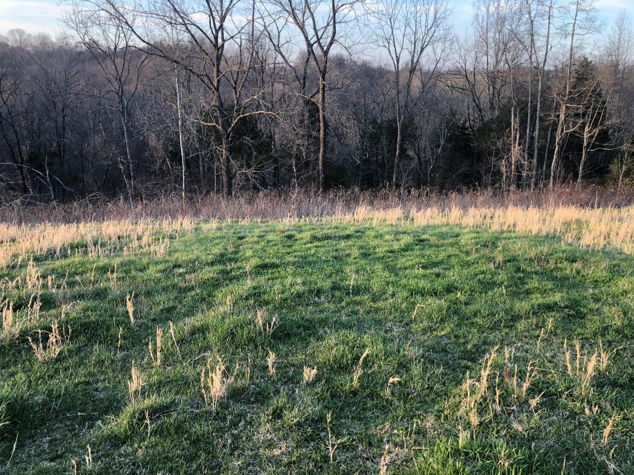
Where one bale of hay was fed
Notes:
This is where one 5’ x 5’ roll of hay was fed the previous year. No additional amendments. It was overseeded the spring after feeding. The zone of influence from feeding hay is 32’. Note that the brown grass, broomsedge was stomped out and replaced with higher palatability and productive plants. Outside the zone of influence a lower quality less desirable species.

Slide 10
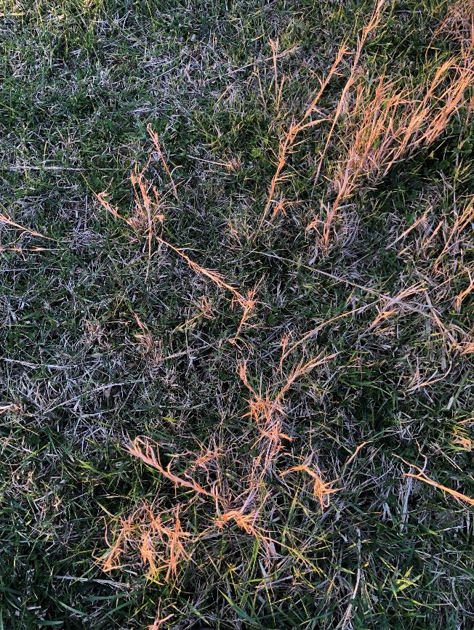
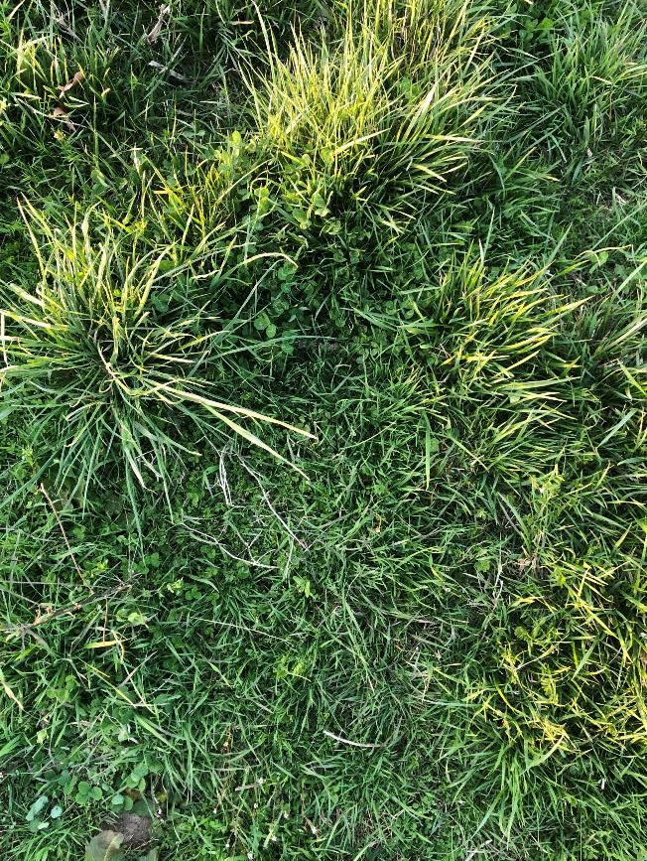
Where hay was fed
Between rolls of hay
Notes:
These pictures relate to the previous slide. The picture on the left is between where the bales were fed. The one on the right is in the middle of where the hay was fed.

Slide 11
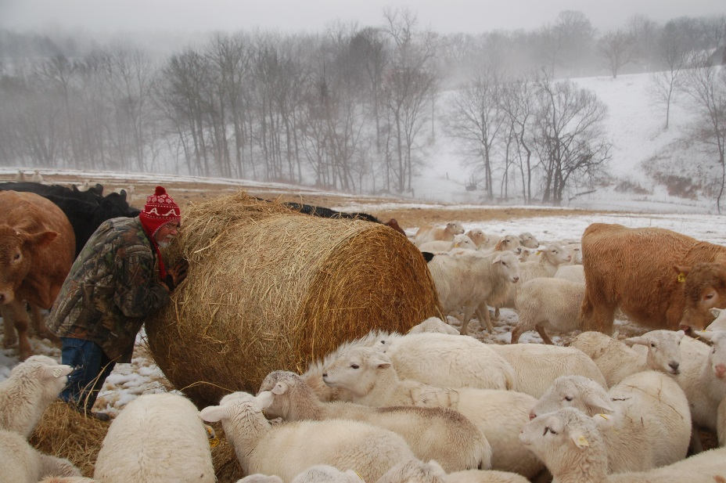
Hay Feeding, strategic placement of carbon and nutrients
  Feed hay and place mineral on low fertility and/or weedy areas
  One ton of hay contains 50-13-48 (Jim Gerrish)
  Adding residue and manure and urine, where hay is fed
Notes:
Hay cutting is an extractive process remoting carbon, and nutrients. The carbon and nutrients are moved to the feeding site. Feeding hay on lower fertility land increases nutrients and plant residue. Increasing desirable species and plant productivity.

Slide 12
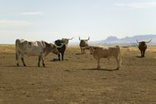
Why Not Manage Soil Organism Habitat
Management of a sterile soil is simpler
The producer supplies everything
  Fertilizer
  Pesticides
  Irrigation
More biomass is removed; however, yields will drop, and weeds will increase if fertilizer and herbicides are not used.
The producer is at odds with nature striving to control it.
Notes:
Picture of overgrazed land with cattle. Not working with nature the soil becomes sterile. The producer has to supply what the plants need. Since there is no habitat for soil organisms yields will drop if inputs don't continue.

Slide 13
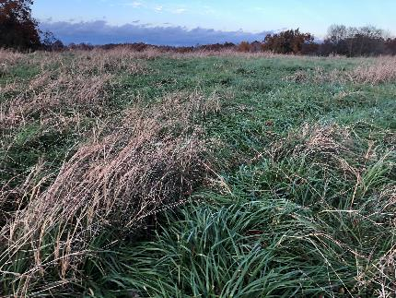
Energy and the food web
(Manage for carbohydrate storage and leaf area)
Agriculture converts the sun's energy into food, feed, and fiber
Carbon is participating in the flow of energy
Two thirds of the plant's energy is released underground through roots and root exudates feeding the below ground herd, the soil food web
Nutrient availability is governed by the detritus-based soil food web and plant interaction
Notes:
Agriculture converts the sun's energy into food, feed, and fiber, Most solar energy captured by plants is not directly . If sunlight hits bare ground, energy is lost as heat. Energy is a flow, not a cycle. harvested; instead, it feeds the belowground food web. Feeding the "underground livestock" is essential.
The energy flow begins when the sun's energy is captured by the plant-based (aboveground) food web. Nutrient availability is governed by the detritus-based (belowground) food web. The interaction of plants, soils, and soil organisms also influences the water cycle.
Pictured, grassland with a long history of high density-short duration grazing and a recovery between grazing of 45 days or longer. This field has not been fertilized in 17 years.

Slide 14
N
95% raw material needed for growth comes from air
Sun
Water
CO2
Notes:
Ninety five percent of raw material needed for growth comes from air. The air space of soil pores is an important component to maintain. When it rains it creates an air exchange underground.

Slide 15
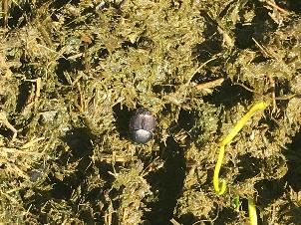
Nutrient Cycling
Pastureland plants' nutrient needs are mainly supplied through the decomposition of organic matter in the soil.
Soil organisms consume organic materials, they retain (immobilize) nutrients. Preventing the loss of nutrients, such as nitrogen, from the root zone.
When fungi and bacteria die or are eaten by other organisms, nutrients are mineralized and slowly released to the soil in plant-available forms.
Some bacteria and fungi provide nutrients to plants in exchange for carbon. “Rhizophagy cycle”
Mycorrhizal and Arbuscular fungi attach to plant roots extending the root system enhancing the plants ability to compete for water and nutrients. They also connect the roots of various plant species facilitating the transfer of nutrients, especially nitrogen and phosphorus between plants
Notes:
Nutrient Cycling
Pastureland plants' annual nutrient needs are mainly supplied through the decomposition of organic matter in the soil. As soil organisms consume organic materials, they retain (immobilize) nutrients in their cells. This process prevents the loss of nutrients, such as nitrogen, from the root zone. When fungi and bacteria die or are eaten by other organisms, nutrients are mineralized and slowly released to the soil in plant-available forms. Nutrient immobilization and mineralization occur continuously throughout the year relative to moisture availability and temperature.
Some bacteria and fungi provide nutrients to plants in exchange for carbon. Particular types of bacteria, called nitrogen fixers, infect clover roots and other legumes, forming visible nodules. These bacteria convert nitrogen from the soil air into a form the plant host can use. Cut nodules in half; if they turn red, they actively convert nitrogen for plant use. When the leaves and roots die and decompose, nitrogen levels increase in the surrounding soil, improving the growth of other plants. Fungi produce hyphae (mycorrhizal fungi) that attach to plant roots and act like an extended root system. These mycorrhizal fungi enhance a plant's ability to compete for water and nutrients. Mycorrhizal fungi also connect the roots of various plant species facilitating the transfer of nutrients, especially nitrogen, and phosphorus, between plants.
In a healthy soil ecosystem, soil biota regulates the flow and storage of nutrients in many ways. For example, they decompose plant and animal residue, fix atmospheric nitrogen, transform nitrogen and other nutrients among various organic and inorganic forms, release plant-available nutrients, mobilize phosphorus, and form mycorrhizal (fungus-root) associations for nutrient exchange. Even applied fertilizers may pass through soil organisms before being utilized by crops.
The rhizophagy cycle is where bacteria and fungi enter plant root and are digested by the plant to a degree. Some reemerge from the plant.

Slide 16
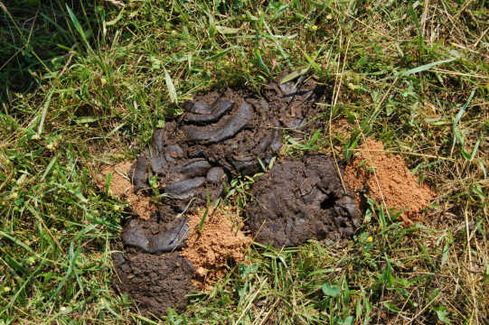
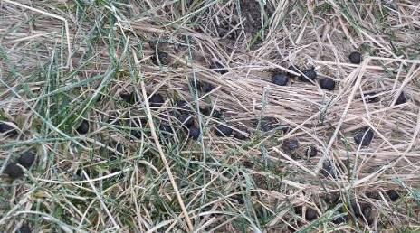
Manure/Urine- cycling nutrients
85-57-190/cow/yr (.23-.15-.52/day) e.g. Nutrients needed (120-30-30)/ .23-.15-.52 x herd number = days to graze to fertilize
120 N needed/ 23 (0.23 N x100 cows) = 5 to 10 days/AC
Fertilize any crop with 100 cows, 11 days/AC =
256-156-572/ac
Notes:
Pictured on left cow manure with a high fiber and signs of tunneling dung beetles next to the pile. Pictured on the right is goat manure pellets which is well distributed. The reason for the span of days to fertilize a pasture is possible nitrogen loss due to volatilization. Volatilization of N can be 50% or more. 85 pounds of Nitrogen per year- 57 pounds of P2O5 per year and 190 pounds of K2O per year. The calculations are based on Nitrogen. 85 pounds of N per year divided by 365 days equals 0.23 pounds of N per day.

Slide 17
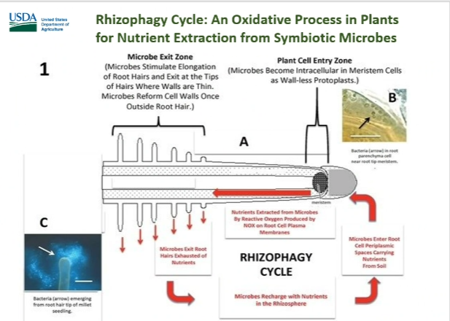
Rhizophagy Cycle
Notes:
Rhizophagy cycle is where microbes enter through the root tip, some of the biology shed their cell walls and are digested or partially digested by the plant, the microbes then exit through root hairs where some reform cell walls once outside of the plant.

Slide 18
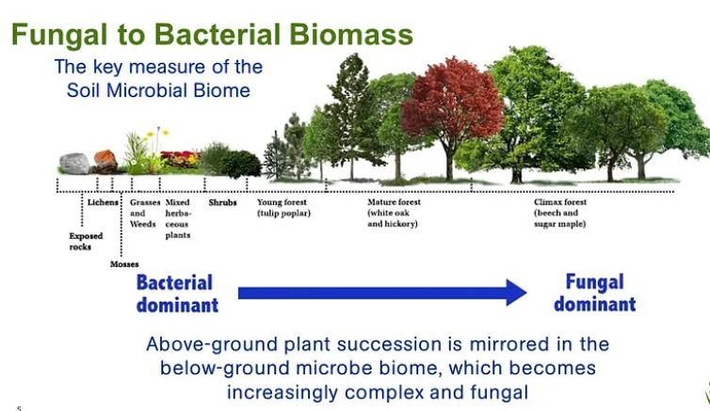
.
Notes:
Grasslands are more bacterial dominated whereas forest are more fungal dominated. Most grasslands would benefit from being more fungal. To move toward a fungal environment manage for forage in a more mature vegetative state (boot to early head stage). Early successional woody plants like shrubs and tulip poplar are typically a balance of bacteria and fungal environment.

Slide 19
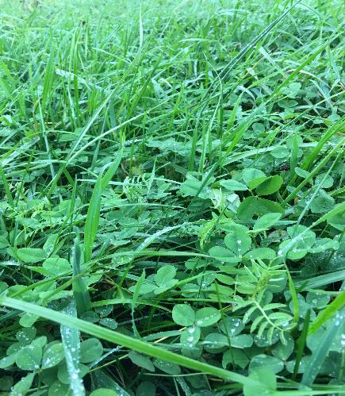
What Affects Soil Organism Habitat?
Soil biota multiplies rapidly when they have food and favorable growing condition. (plant cover, soil residue cover, plant diversity, roots)
Grazing jump-starts the soil food web, increasing nutrient cycling
Organisms affect each other through predation, competition, and facilitation of food and space.
Notes:
What Affects Soil Organism Habitat?
Soil biota multiplies rapidly when they have food and favorable growing condition. Ample supplies of organic materials such as roots and plant residue provide critical food sources. Seasonal biological activity patterns coincide with plant growth stages, temperature, moisture, litter fall, and root die-off. Active bacteria require films of water in soil pores, whereas fungi can function in drier conditions. When the soil is too dry, bacteria and fungi become less active or temporarily shut down, protozoa form dormant cysts, and most other organisms decline. In saturated and anaerobic soil, denitrifying bacteria (bacteria that convert nitrates into nitrites and ammonia) cause denitrification. Organisms affect each other through predation and competition for food and space. Livestock digest organic matter, defecate and urinate organic material speeding up the carbon and nitrogen cycles. Picture is tall fescue, white clover and hairy vetch.

Slide 20
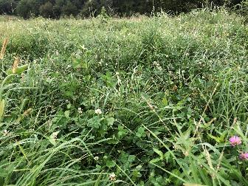
What Affects Soil Organism Habitat?
(continued)
Seasonal biological activity coincides with plant growth stages, temperature, moisture, litter fall, and root die-off
When the soil is dry, bacteria and fungi become less active or temporarily shut down, protozoa form dormant cysts, and most other organisms decline. (plant cover and soil residue)
In saturated and anaerobic soil, denitrifying bacteria (bacteria that convert nitrates into nitrites and ammonia) cause denitrification.
Proper grazing builds soil, take advantage of high production times
Notes:
Picture is fall tall fescue, orchardgrass, red and white clover, johnsongrass and foxtail millet. The stage of maturity pictured is late vegetative (top of phase 2 growth) ideal for a balance of animal productivity, forage production and soil health. Plant cover and plant residue improve moisture availability over an extended time. Strongly aggregated soil is more porous and has more air movement and moisture storage decreasing denitrification. Denitrification decreases nitrogen availability. Proper grazing management improves soil health. When high production of grass is possible manage for maximum cover, build carbohydrate storage and maintain leaf area.

Slide 21
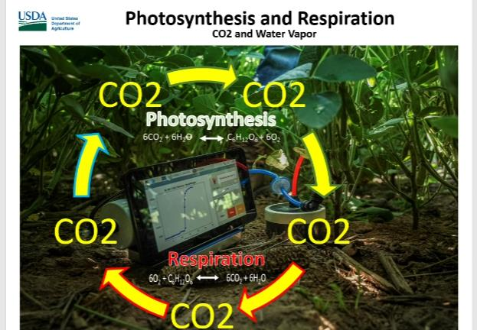
..
Notes:
A high degree of plant canopy creates a microclimate of higher CO2 and water vapor increasing plant growth.

Slide 22
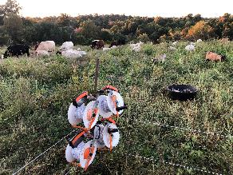
Management Strategies to Improve
Soil Organism Habitat
Plant cover, plant residue, plant diversity, roots, soil life, darker soil color, and reduces soil compaction, improve soil organism habitat:
Plant canopy cover and plant residue moderate soil temperatures and improve moisture availability.
Diverse vegetation produces different: root structures, times of growth, types of root exudates, and plant residue providing different food sources for soil biota. Resulting in a diverse microbial population
Minimize disturbances include compaction, erosion, soil displacement, tillage, over grazing, catastrophic fires, specific pesticide applications, and excessive pesticide usage
Reduce impacts of compaction especially when soils are saturated.
Notes:
Management Strategies to Improve Soil Organism Habitat
Any management technique that improves the following indicators will improve soil organism habitat: Plant cover, soil residue, plant diversity, roots, soil life, darker soil color, and reduces soil compaction. Plant canopy cover and soil residue moderate soil temperatures and improve moisture availability. The higher the ambient temperature, the more significant the effect cover and residue will have. Increased production presents a significant opportunity to improve soil life habitat. Diverse vegetation produces different: root structures, times of growth, types of root exudates, and plant residue and thus provide different food sources for soil biota. Plant diversity and the pattern of plant distribution affect soil organisms.
Some soil perturbations are a normal part of soil processes or necessary for agriculture and other land uses. However, some disturbances significantly impact soil biology and can be minimalized to reduce their adverse effects. These disturbances include compaction, erosion, soil displacement, tillage, catastrophic fires, specific pesticide applications, and excessive pesticide usage.
If soils are naturally saturated at certain times of the year, consider reducing the stocking rate during that time or being seasonal (stocker cattle or contract graze), not having any stock then. Calving time and marketing can help reduce the stocking rate at strategic times. One option is to run fewer cows and keep calves till they are long yearlings, and this lowers numbers, yet you can market the same cattle weight. Confining livestock in "Heavy Use Area Protected" locations can help sustain soil health and pasture productivity when soils are saturated, and there is insufficient ground cover.
Picture is geared reels of polywire with two strands for multispecies of cattle, sheep, and goats.

Slide 23
Biological:
Biomass of organisms above ground in the pasture and below ground within the pasture soil.
Organisms Standing crop biomass lbs/a
Above ground
  1200 Dairy cow¹ or 587
  1200 Beef cow² 450
  Pasture³ 2500
  Total 3,018
Below ground
  Pasture roots⁴ 2500
  Bacteria 2052
  Actinomycetes 2052
  Fungi 6244
  Algae 219
  Protozoa 80
  Nematodes 62
  Mites 65
  Collembola 65
  Earthworms 624
  Other fauna 40
  Total 14,003 (4.6 x>)
Adapted in part from Brady and Weil 2002.
1. Cow producing 40 lbs milk/day 180 days/acre, 50% of forage
standing crop consumed, 5 rotations/year.
2. Cow weaning 600 lb calf 3 acres/year.
3. Cool-season grass-clover pasture, 10 inches tall at grazing.
4. Roots equal top growth at grazing.
(518 avg wt. @2.67 ac/cow)
Notes:
Source: Ed Rayburn, West Virginia
Citations from Dr. Ed Rayburns paper on Pasture Ecology: “Managing Things That We Cannot See”. There is almost 5 times more biomass underground than above ground and that's counting the weight of the cow.

Slide 24
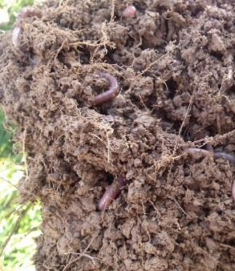
Interaction of the Cow with Soil Ecology
Pasture Ecology: Managing Things That We Cannot See. Edward B. Rayburn, Extension Specialist Agriculture and Natural Resources September 2008
When a cow grazes removing leaves some roots slough (up to 30% per year)
Earthworms consume dying roots
Bacteria decompose dead roots
Earthworms return eating bacteria
Some bacteria prefer the highly digestible sugars and proteins while other bacteria prefer the readily digestible fiber; similar to bacteria in the cow’s rumen.
Fungus and actinomycetes go to work digesting the less digestible fiber and lignin
Notes:
Citations from Dr. Ed Rayburns paper on Pasture Ecology: “Managing Things That We Cannot See”.
Pictured is soil aggregation and earthworms.

Slide 25
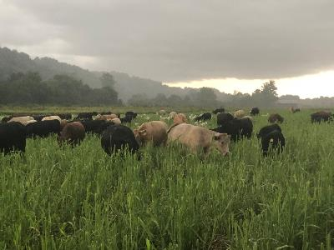
Interaction of the Cow with Soil Ecology
(Continued)
Cows tread down part of the pasture sward. Allowing earthworms and detritus feeding insects, mites, bacteria, and fungus to consume it
Predatory nematodes and protozoa eat the bacteria and release a large part of the nitrogen back into the soil where it is plant available
Dung is quickly inhabited by dung beetles, fly larva, rove beetles that eat fly larva, earthworms, and bacteria.. Later fungus and actinomycetes invade the cow pie and help decompose the more resistant forms of carbon
Nitrogen enters the soil through nitrogen rich root exudates, root and nodule death, livestock trampling, and dung and urine deposition
Notes:
Picture is cattle on a sorghum sudangrass mix pasture. Grazing livestock have the potential to tread down the pasture sward so soil life can consume it. Then the web of life begins. Dung is predigested plant material which is more accessible for soil life.

Slide 26
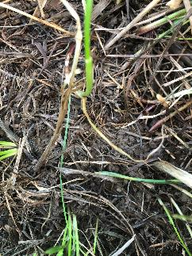
Interaction of the Cow with Soil Ecology
(Continued)
With time the legume roots meet with mycorrhizal fungus which attaches to the root. The mycorrhizal fungus also attach to grass roots.
  The fungus offers the clover extra phosphate in exchange for carbohydrate and nitrogen.
  The fungus provides part of the nitrogen to the grass from which it obtained the phosphate in exchange for carbohydrates.
  The fungus also obtains phosphate and trace minerals from the soil that it uses in this bartering system
Notes:
Legume nitrogen enters the soil through nitrogen rich root exudates, root and nodule death, livestock trampling, and dung and urine deposition. This nitrogen is made available to grasses and legumes as the organic matter is broken apart by the shredders and decomposed by the detritus feeders, bacteria, and fungus.
With time the legume roots meet with mycorrhizal fungus which attaches to the root. The mycorrhizal fungus also attach to grass roots. Then the fungus offers the clover extra phosphate in exchange for carbohydrate and nitrogen. The fungus provides part of the nitrogen to the grass from which it obtained the phosphate in exchange for carbohydrates. The fungus also obtains phosphate and trace minerals from the soil that it uses in this bartering system.
Picture is soil residue after pulling back a canopy of grass leaves.

Slide 27

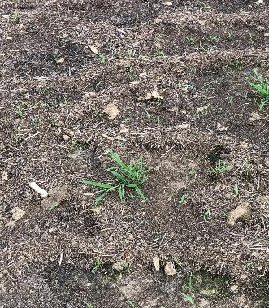
Soil Stability and Erosion
Fungal filaments and exudates from microbes and earthworms help bind particles into stable aggregates, improving water infiltration and protecting soil from erosion, crusting, and compaction.
Macropores formed by earthworms and other burrowing creatures facilitate water movement into and through the soil.
Good soil structure enhances root development
Sheet erosion due to lack of cover removes or redistributes the surface layer of the soil
Terracettes and pedestal erosion are signs of significant soil movement
Eroded or scoured soils lack soil biota so they are slow to respond to management and inputs
Notes:
Compaction by grazing animals and vehicles – Ideal soils are approximately 50 to 60% poor space comprising a variety of poor sizes and lengths with air space comprised of equal parts air and water. Soil compaction reduces the larger pores and pathways, thus reducing the amount of habitat for nematodes and the larger soil organisms. The size and continuity of pores control whether larger microbes, such as protozoa, can prey upon bacteria and fungi. Arthropods are severely affected by compaction. Among nematodes, the predatory species are most sensitive to compaction, followed by fungal- feeders, then bacterial feeders. Compaction also reduces water infiltration and increases runoff and flooding. Compaction can also cause the soil to become anaerobic, increasing nitrogen losses to the atmosphere.
Picture is the results of hay feeding in wet conditions with less than favorable ground cover. When moving hay rings don’t drive a tractor through these areas with not cover.
Pictured left, strong water stable soil aggregates are formed by managing for good habitat for soil life. Pictured right are debris lines formed by erosion. These lines are called terracettes. This increases infiltration, reduces runoff, improving moisture availability for plant growth. Soil life including fungal filaments and exudates from microbes and earthworms bind particles into stable aggregates. Macropores formed by earthworms and other burrowing creatures facilitate water movement into and through the soil.
.

Slide 28
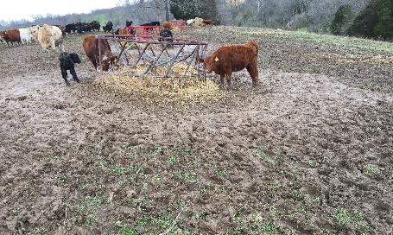
Compaction by grazing animals and vehicles
Ideal soils are approximately
  50 to 60% poor space comprising a variety of poor sizes and lengths
  Pore space comprised of equal parts air and water.
Soil compaction reduces the larger pores and pathways, thus
  reducing the amount of habitat for nematodes and the larger soil organisms.
  The size and continuity of pores control whether larger microbes, such as protozoa, can prey upon bacteria and fungi.
  Arthropods are severely affected by compaction.
Among nematodes, the predatory species are most sensitive to compaction, followed by fungal- feeders, then bacterial feeders.
Compaction also reduces water infiltration and increases runoff and flooding.
Compaction can also cause the soil to become anaerobic, increasing nitrogen losses to the atmosphere.
Notes:
Compaction by grazing animals and vehicles – Ideal soils are approximately 50 to 60% poor space comprising a variety of poor sizes and lengths with air space comprised of equal parts air and water. Soil compaction reduces the larger pores and pathways, thus reducing the amount of habitat for nematodes and the larger soil organisms. The size and continuity of pores control whether larger microbes, such as protozoa, can prey upon bacteria and fungi. Arthropods are severely affected by compaction. Among nematodes, the predatory species are most sensitive to compaction, followed by fungal- feeders, then bacterial feeders. Compaction also reduces water infiltration and increases runoff and flooding. Compaction can also cause the soil to become anaerobic, increasing nitrogen losses to the atmosphere.
Picture is the results of hay feeding in wet conditions with less than favorable ground cover. When moving hay rings don’t drive a tractor through these areas with not cover.
.

Slide 29
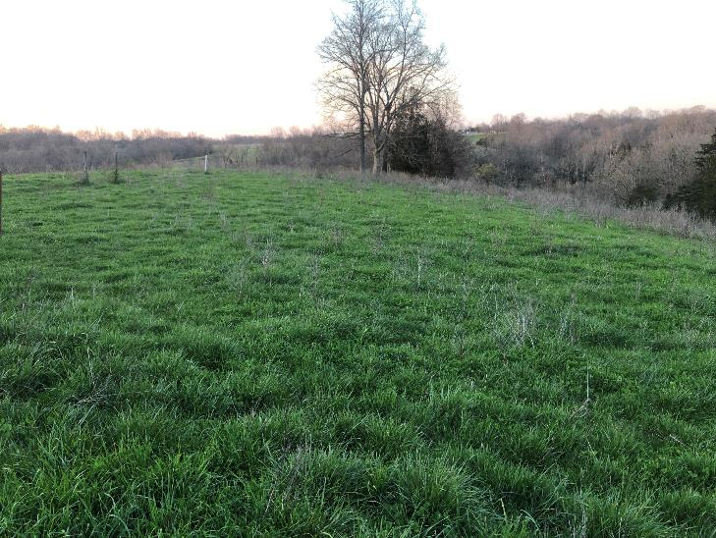
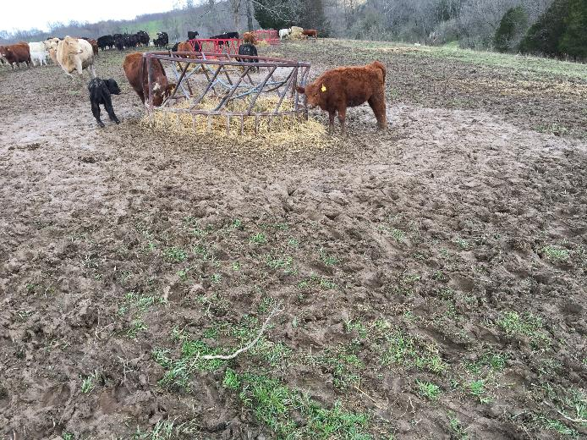
Bale graze during heavy rain One year later with reseeding and rest
Notes:
Pictures of before and after bale grazing in wet conditions. Lengthening the recovery time after severe compaction can help remediate the issue. Plants and roots are the cure for compaction.

Slide 30
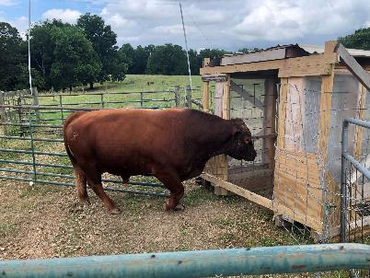
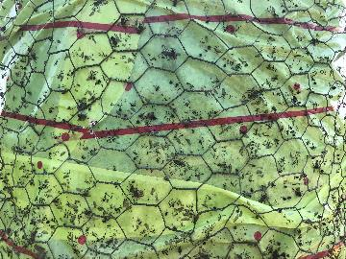
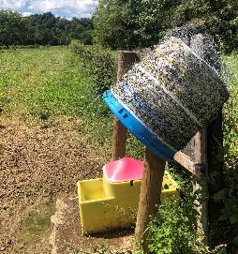
Pest Control
Walk through fly trap
Pesticides and anthelmintics (dewormers) that kill aboveground insects can also kill beneficial soil insects.
Herbicides and foliar insecticides applied at recommended rates have a more negligible impact on soil organisms.
Anthelmintics, especially long-acting ones used on livestock, can severely impact soil life. Garlic powder fed in mineral is an alternative, fly paper can also lessen fly numbers.
Fungicides and fumigants have a significant impact on soil organisms.
Flieseaten off of Fly paper with bird protection
Fly paper with bird protection
Notes:
Pesticides and anthelmintics (dewormers) that kill aboveground insects can also kill beneficial soil insects. Herbicides and foliar insecticides applied at recommended rates have a more negligible impact on soil organisms. Anthelmintics, especially long-acting ones used on livestock, can severely impact soil life. Fungicides and fumigants have a significant impact on soil organisms.
Picture top right is a red angus bull entering a wokthrough fly trap that keeps flies at an economic threshold of less than 200 flies per animal. Picture bottom left is an old protein tub with 12” fly paper wrapped around it and covered in chicken wire to keep from catching fly eating birds. Bottom right is where flies have been eaten off the fly paper by birds.

Slide 31
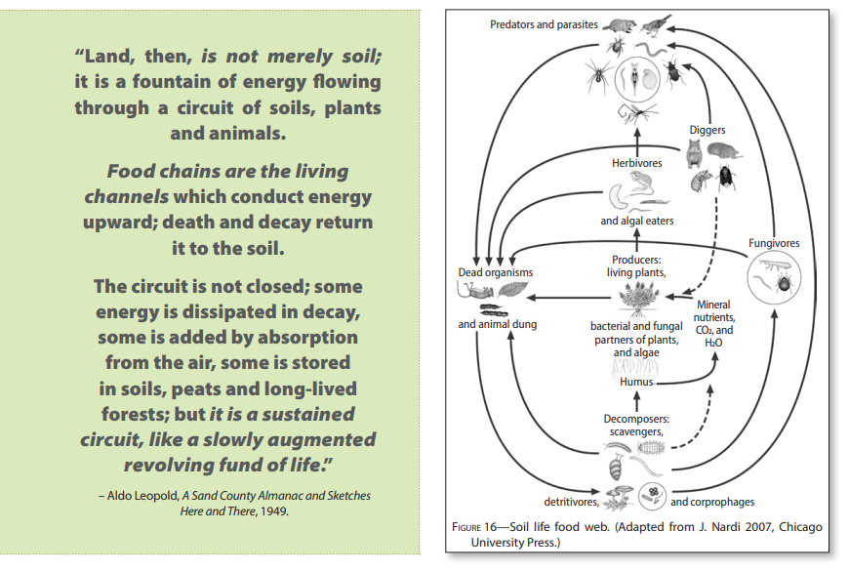
Aldo Leopold quote and the Soil Life food web
Notes:
Food web showing how soil life are connected and dependent on one another. The soil life food web starts with Producers, living plants consumed by herbivores.

Slide 32
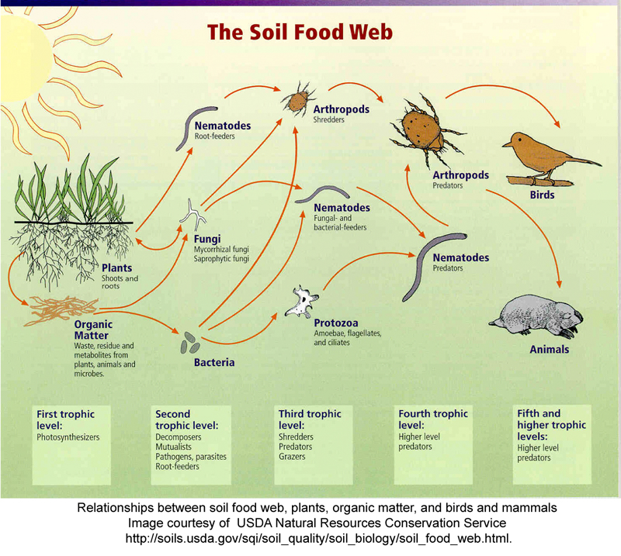
3
The Underground Community
Notes:
Depicting the connectiveness of underground life

Slide 33
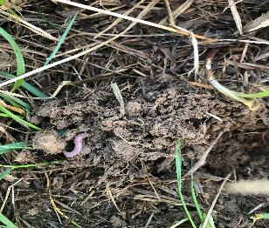
The Underground Community
Soil aggregates
Soil biota, includes an incredible diversity of organisms.
Tons of soil organisms, including microorganisms (e.g., bacteria, fungi, and algae) and macro-organisms (e.g., mites, springtail, spiders, beetles, bees.), can live in an acre of pastureland soil and are more diverse than the community of plants and animals above ground.
Soil biota concentrate in plant residue in the upper few inches of soil along with the predominance of roots. With improved management over time the soil and rooting depth are improved.
The larger soil organisms, such as millipedes, beetles, and microarthropods, shred dead leaves and residue, mix them with the soil, and make organic material more accessible to bacteria and other microorganisms. Livestock are big shredders.
Ants and other macro-organisms tunnel through soils even in drier pasturelands.
Notes:
Soil organisms interact with one another, with plant roots and their environment, forming the soil food web. Soil biota, the biologically active powerhouse of soil, includes an incredible diversity of organisms. Tons of soil organisms, including microorganisms (e.g., bacteria, fungi, and algae) and macro-organisms (e.g., mites, springtail, spiders, beetles, bees.), can live in an acre of pastureland soil and are more diverse than the community of plants and animals above ground. Plant residue in the upper few inches of soil and along roots is where soil biota concentrate.
The larger soil organisms, such as millipedes, beetles, and microarthropods, shred dead leaves and residue, mix them with the soil, and make organic material more accessible to bacteria and other microorganisms. Ants and other macro-organisms tunnel through soils even in drier pasturelands.
Predators in the soil food web include centipedes, spiders, mites, ants, insects, and beetles, all controlling the population of soil biota. Small organisms, including mites, springtails, nematodes, and one-celled protozoa, graze on even smaller bacteria and fungi. Other organisms feed on dead roots, shredded residue, and the fecal by-products of the larger organisms. Microscopic bacteria and fungi comprise the bulk of the biota in the soil. They finish the decomposition process by breaking down the remaining material and storing its energy and nutrients in their cells. Fungi can digest even lignin, which ruminants cannot do. Algae and fungi are the first organisms to colonize rock and form "new soil" by releasing substances that disintegrate rock.
Observation and measurement can track changes at the same location in the field, enabling comparison between the baseline status and that after several seasons of application of a management practice. No single indicator provides a good assessment of soil health so using multiple methods of assessment provides a fuller picture of soil health.
The best way to make assessments is in the field. A reference site demonstrating the potential of a soil group is ideal however for a quick comparison to the site being evaluated it can be an area with less disturbance like that under a fenceline. This can provide an estimate of potential ecosystem function for the site.
Soil organisms provide a biologic indication of soil health and how complete and complex the soil community is- which top predators, prey, herbivores, and other functional groups are present and what proportions. Begin by collecting these in groups at a baseline point in time, continue doing so after you implement practices, and then compare the results. Pitfall traps or performing Berlese funnel surveys are useful in conducting these surveys. (See Xerces Farming with Soil Life: A Handbook for Supporting Soil Invertebrates and Soil Health on Farms).
Pitfall Traps catch animals, mostly invertebrate macrofauna, that move across the soil surface. Think about timing, pitfall traps should be used during the growing season when soil animals are active. Avoid rainy periods because the trap can fill with water making them ineffective. Berlese funnels represent a simplified method of surveying mobile soil-dwelling organisms, especially small arthropods such as mites, springtails, and small insects. In this method, a shallow soil or leaf litter sample is collected and placed under a light. Over a period of days or hours depending on the sample size as the light warms and dries the soil sample, organisms move away from the light and heat and into a trap. Baermann funnel surveys are used to collect nematodes from a soil sample using a funnel, paper filter and water. A dissecting microscope is needed to identify and count the active nematodes from the sample. These funnels can be used to examine other creature of water films-rotifers, protozoa, tardigrades.
The larger soil organisms, such as millipedes, beetles, and microarthropods, shred dead leaves and residue, mix them with the soil, and make organic material more accessible to bacteria and other microorganisms. Ants and other macro-organisms tunnel through soils even in drier pasturelands.
Predators in the soil food web include centipedes, spiders, mites, ants, insects, and beetles, all controlling the population of soil biota. Small organisms, including mites, springtails, nematodes, and one-celled protozoa, graze on even smaller bacteria and fungi. Other organisms feed on dead roots, shredded residue, and the fecal by-products of the larger organisms. Microscopic bacteria and fungi comprise the bulk of the biota in the soil. They finish the decomposition process by breaking down the remaining material and storing its energy and nutrients in their cells. Fungi can digest even lignin, which ruminants cannot do. Algae and fungi are the first organisms to colonize rock and form "new soil" by releasing substances that disintegrate rock.

Slide 34
The Underground Community
(continued)
Predators in the soil food web include centipedes, spiders, mites, ants, insects, and beetles, all controlling the population of soil biota.
Small organisms, including mites, springtails, nematodes, and one-celled protozoa, graze on even smaller bacteria and fungi.
Other organisms feed on dead roots, shredded residue, and the fecal by-products of the larger organisms.
Microscopic bacteria and fungi comprise the bulk of the biota in the soil. They finish the decomposition process.
Fungi can even digest lignin, which ruminants cannot do. Algae and fungi are the first organisms to colonize rock and form "new soil".
Notes:
Predators control the population of soil biota. Small organisms graze on smaller bacteria and fungi. Other organisms feed on dead roots, shredded residue, and the fecal by products of larger organisms. Microscopic bacteria and fungi finish the decomposition process. Fungi can even digest lignin.

Slide 35
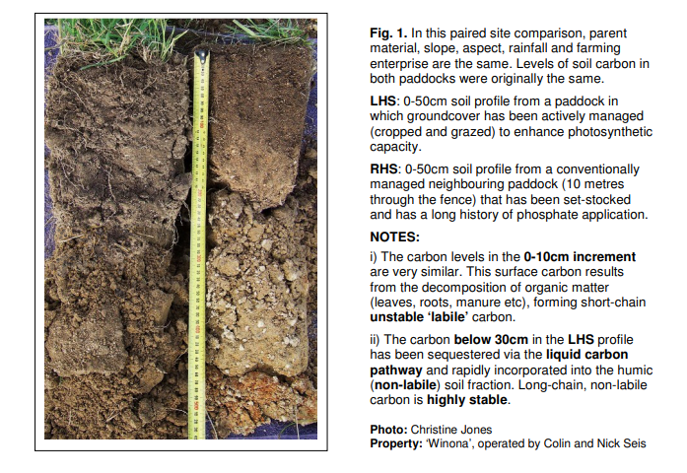
Carbon That Counts, Christene Jones
Comparing Optimizing photosynthetic activity for Thirty years on the left, and Conventional Management on the same site on the right
(Left and Right Horizon Solubilized Minerals)
LHS RHS
Notes:
Biological carbon capture and storage begins with photosynthesis, a natural process during which green leave transform sunlight energy, carbon dioxide and water into biochemical energy.
For plants, animals and people, carbon is not a pollutant, but the stuff of life. All living things are based on carbon. Humification, a process in which simple sugars are resynthesized into highly complex carbon polymers. Humus polymers are made up of carbon and nitrogen from the atmosphere, combined with a range of minerals from the soil. These organo-mineral complexes form a stable and inseparable part of the soil matrix that can remain intact for hundred of years. Humified carbon differs physically, chemically and biologically from the labile pool of organic carbon that typically forms near the soil surface. Labile carbon arises principally from biomass inputs which are readily decomposed.

Slide 36
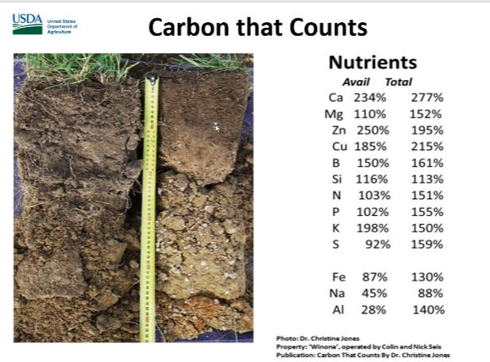
Left horizon solubilized minerals via microbes energized by increased liquid carbon
Notes:
Levels of both total and available plant nutrients, minerals and trade elements have dramatically improved in the LHS soil, due to solubilization of the mineral fraction by microbes energized by increased levels of liquid carbon. In the positive feedback loop sequestration enhances mineralization which in turn enhances humification.

Slide 37
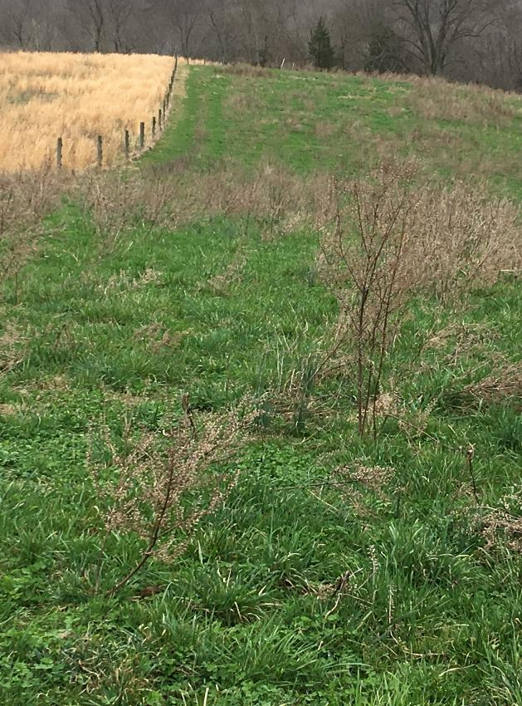
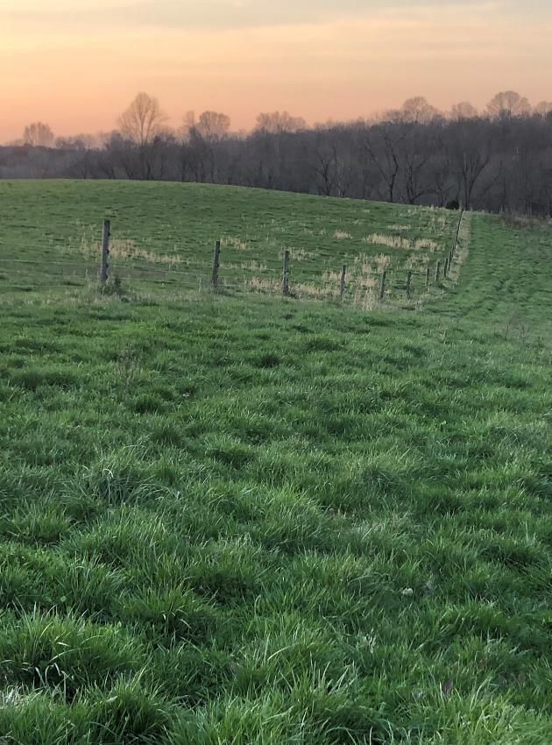
Before bale grazing After bale grazing
Notes:
The focus is on the broomsedge area on the upper side of the fence. The first picture is prior to bale grazing and the right picture is a year after bale grazing. The bale grazing area was frost seeded with legumes after feeding the hay. No fertilizer or lime were applied in this period.

Slide 38
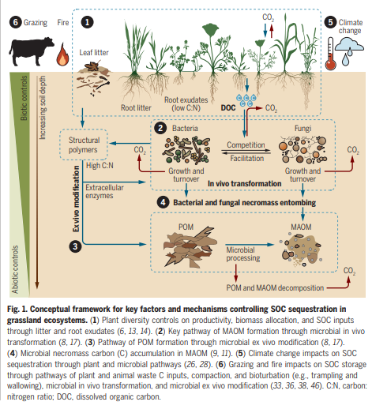
4
Notes:
DOC is dissolved organic carbon a small but important fraction of total soil carbon that is involved in an enormous variety of complex interactions with plants, microbes and minerals. POM, plant organic matter microbial processed to develop MAOM, mineral associated organic matter. MAOM is more plant available. The positive feedback loop render the liquid carbon pathway somewhat akin to perpetual motion.

Slide 39
Assessing the Underground Community
No single indicator provides a good assessment of soil health
Comparison between
  baseline status and
  a management practice applied over several seasons
A reference site demonstrating the potential of a soil group is ideal
  reference sheet for the soil group
  fence line
  Undisturbed area can provide an estimate of potential ecosystem function for the site.
Soil organisms provide a biologic indication of soil health, the number and representation of functional groups present and their proportions.
Notes:
Observation and measurement can track changes at the same location in the field, enabling comparison between the baseline status and that after several seasons of application of a management practice. No single indicator provides a good assessment of soil health so using multiple methods of assessment provides a fuller picture of soil health. The best way to make assessments is in the field. A reference site demonstrating the potential of a soil group is ideal however for a quick comparison to the site being evaluated it can be an area with less disturbance like that under a fenceline. This can provide an estimate of potential ecosystem function for the site.
Soil organisms provide a biologic indication of soil health and how complete and complex the soil community is- which top predators, prey, herbivores, and other functional groups are present and what proportions. Begin by collecting these in groups at a baseline point in time, continue doing so after you implement practices, and then compare the results. Pitfall traps or performing Berlese funnel surveys are useful in conducting these surveys. (See Xerces Farming with Soil Life: A Handbook for Supporting Soil Invertebrates and Soil Health on Farms).
Pitfall Traps catch animals, mostly invertebrate macrofauna, that move across the soil surface. Think about timing, pitfall traps should be used during the growing season when soil animals are active. Avoid rainy periods because the trap can fill with water making them ineffective. Berlese funnels represent a simplified method of surveying mobile soil-dwelling organisms, especially small arthropods such as mites, springtails, and small insects. In this method, a shallow soil or leaf litter sample is collected and placed under a light. Over a period of days or hours depending on the sample size as the light warms and dries the soil sample, organisms move away from the light and heat and into a trap. Baermann funnel surveys are used to collect nematodes from a soil sample using a funnel, paper filter and water. A dissecting microscope is needed to identify and count the active nematodes from the sample. These funnels can be used to examine other creature of water films-rotifers, protozoa, tardigrades.

Slide 40
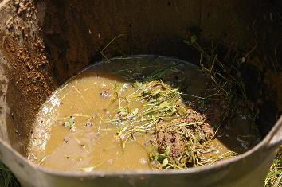
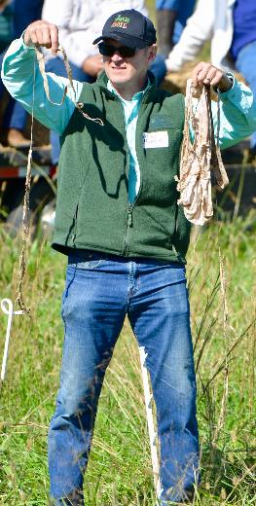
Assessing the Underground Community (cont)
Pitfall traps catch animals, mostly invertebrate macrofauna, that move across the soil surface. (See Xerces Farming with Soil Life: A Handbook for Supporting Soil Invertebrates and Soil Health on Farms).
Berlese funnels a simplified method of surveying mobile soil-dwelling organisms, especially small arthropods such as mites, springtails, and small insects. A shallow soil or leaf litter sample is collected and placed under a light.
Baermann funnel surveys are used to collect nematodes from a soil sample using a funnel, paper filter and water. A dissecting microscope is needed to identify and count the active nematodes from the sample. Other creatures of water films-rotifers, protozoa, tardigrades can also be assessed with this method.
Notes:
These tools are easily made at home. It is best if comparing sites to have similar environmental conditions and to collect on several sites. Picture dung beetle assessment by placing dung in a tub of water.

Slide 41
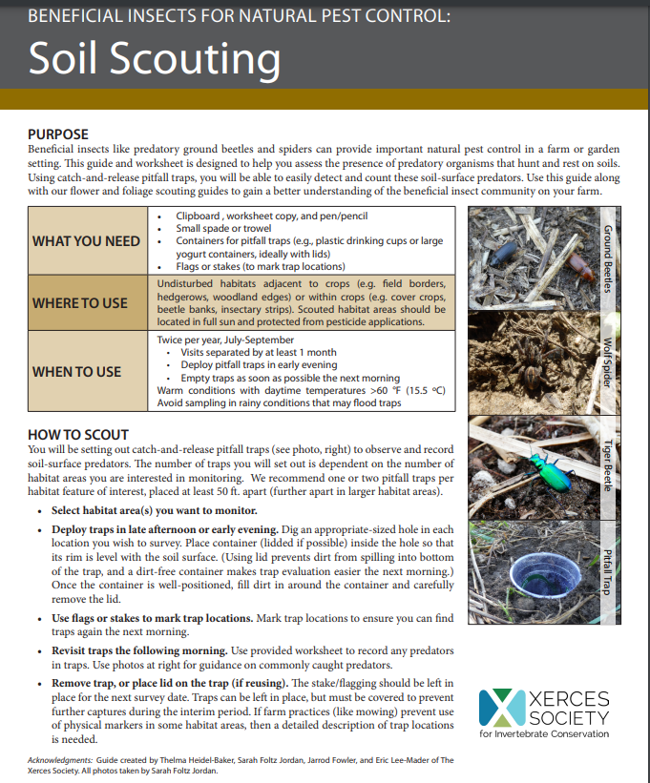
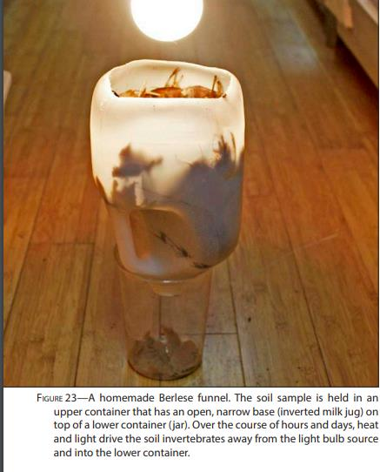
XERCES SOCIETY
Notes:
Soil Scouting technique described by the Xerces Society.

Slide 42
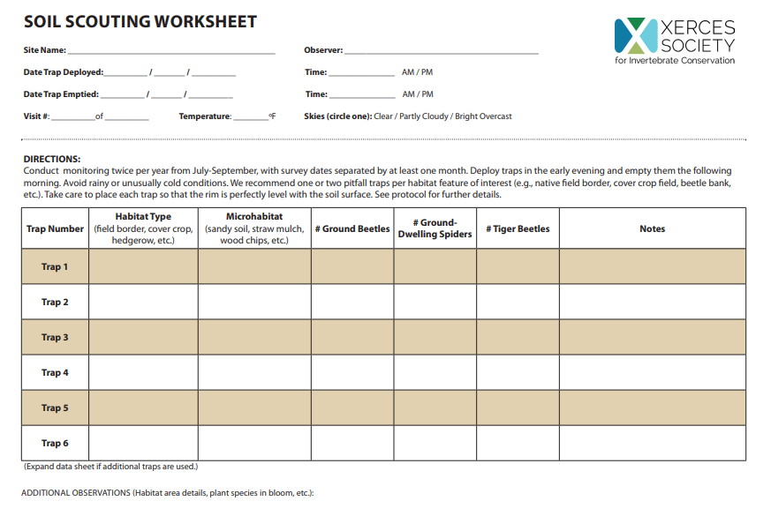
5
Notes:
Soil Scouting worksheet, recording habitat type, microhabitat, Number of ground beetles (shredders), ground dwelling spiders, and tiger beetles (fast predatory insects).

Slide 43
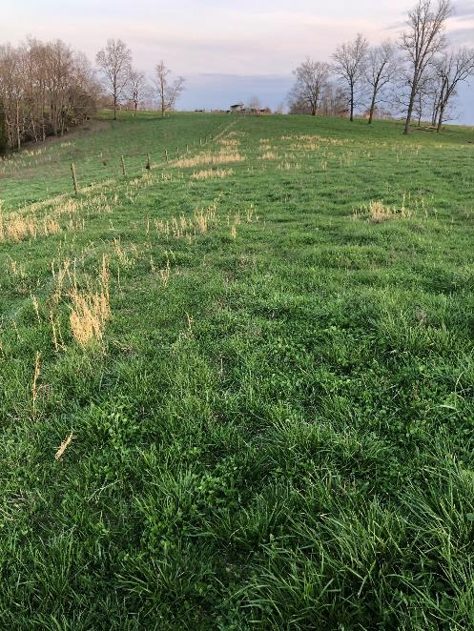
Pastureland Assessment Tools
Both Pasture Condition Score (PCS) and Determining Indicators of Pastureland Health (DIPH) do a good job of assessing strong and weak indicators of pastureland
PCS considers all pastures with the same potential with a max score of 50
DIPH compares pastures within a soil group to a pasture reference (evaluation) sheet or site, recognizing limitations of soil groups, DIPH also identifies attributes of biological integrity, hydrologic function, soil site stability and livestock quality management factor
Notes:
The Pasture Condition Score (PCS) tool has been around for several years. Determining Indicators of Pastureland Health (DIPH) is relatively new it’s a tool patterned after the tool for assessing rangeland.

Slide 44
Indicators influencing the functioning of soil and soil life:
PRIMARILY INDICATORS | OTHER INDICATORS
plant cover | desirable plants,
soil residue, | percent legume
plant diversity | invasive plants
soil compaction | grazing utilization
roots | severity of use
soil color | livestock concentration areas
soil life | plant vigor
Notes:
All indicators have value to soil health. The ones listed as primary have the most influence on changing soil health.

Slide 45
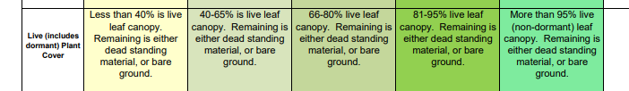
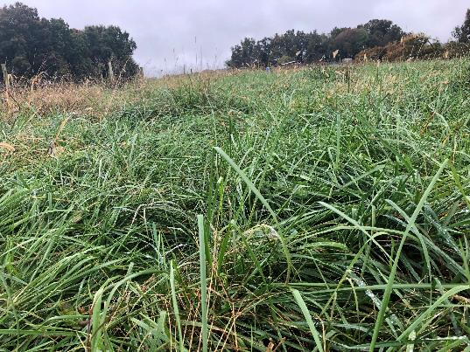
Plant Cover (Resource Concerns: Aggregate Instability, Organic Matter Depletion, Soil Organism Habitat Loss or Decline), (SSS, HF)
Notes:
Plant Cover the protective skin of the soil, the first layer of protection for the soil. Plant cover reduces the impact of the raindrop which is falling at a speed of about 30 mph. If not impeded it acts like a bomb detaching and splattering soil which is, then transported via water or wind and ultimately deposited oftentimes off-site contaminating water. Suspended solids like soil are very hard to clean out of water. Soil has a negative charge which allows nutrients, pesticides, and pathogens to attach to it and be carried potentially contaminating water. Plant cover slows runoff and creates some deposition of soil in the field.
Plant cover can moderate soil temperature by 15 or more degrees and reduce evaporation. Moderate soil temperature and reduced evaporation significantly increase moisture availability. This makes the soil more hospitable for soil life. Soil and soil life are very beneficial providing many benefits including nutrient availability and moisture for plant growth. Plant cover is also the beginning of the carbon flow or cycle once photosynthesis occurs.

Slide 46


Plant Residue
(Resource Concerns: Aggregate Instability, Organic Matter Depletion, Soil Organism Habitat Loss or Decline), (HF, BI)
Or strong water stable soil aggregates with numerous to abundant signs of soil life
Notes:
Plant Residue (Litter) is the second layer of protection for the soil. Plant cover softens the impact of the raindrops. Residue slows water even more, providing time for infiltration. Soil residue also feeds soil life which makes the soil more porous, improving infiltration even more. Soil residue like plant cover reduces evaporation and conserves moisture. To achieve optimum benefits, you need both plant cover and soil residue to protect soil from evaporation, runoff, wind erosion, and to improve water infiltration.

Slide 47


Plant Diversity
(Resource Concerns: Aggregate Instability, Soil Organism Habitat Loss or Decline), (BI, LMQF)
Or
good soil aggregates (crumbly soil) and numerous to abundant signs of soil life rates
Notes:
Plant diversity has a direct relationship with soil life diversity. Functional groups include: cool season grass, warm season grass, legumes, and forbs. Species must comprise 15% or more of the stand to count as a representative of a functional group. A group of individual species which add up to 15% can represent a functional group.

Slide 48



Soil Compaction Roots, Soil Color, Soil Life
(Resource Concerns: Compaction, Aggregate Instability, Soil Organism Habitat Loss or Decline) (SSS, HF, BI)
Notes:
Compaction and Roots are the primary indicators, color and soil life are more talking points in the PCS.

Slide 49

6
Pasture Condition Score Sheet – 10 Indicators
What is the weak link?
Indicators
Desirable Plants
Percent Legume
Plant Cover
Plant Diversity
Plant Residue (dead)
Uniformity of Use
Good Rating
61% or higher
21% -40%, no grass loss
81% or higher live leaf cover; remaining is dry standing or bare ground
4 species in 2 funct. grp or 3 species in 3 f. groups or 3 sp. In 2 funct. grp with another funct. grp represented by minor species (15% of stand to count species &/or funct. grp)
61% ground cover, w/good biological activity
Pasture grazed evenly throughout with minor overgrazed and some under grazed areas, especially near water points
Notes:
This is an example of a good rating on all 10 indicators in the Pasture Condition Score Sheet.

Slide 50

Pasture Condition Score Sheet- (continued)
What is the weak link?
Indicators Good rating
Good Rating- Continued
Livestock Concentration areas
Soil Compaction & Soil Regenerative Features
Plant Vigor
Erosion
Further than 100’ to water and are not a direct conveyance to water and not over 0.1 ac, including trails
Compaction: minor dense or platy layers; good aggregates (crumbly soil);
Roots: Few horizontal with mostly downward;
Color: Soil horizon moderately darker than subsoil;
Soil Life: signs numerous throughout
Good recovery of desirable forage, light and dark green forage present
Sheet and Rill: Plant density high, runoff low, good infiltration. May have evidence of past erosion if present; Wind: Minimal soil exposed, some detached vegetation windrolled, minor plant damage; Streambank and or Shoreline: Eroding at crossings and entrances; all the bank vegetation is intact, and banks are stable. Gully: Stable with vegetative cover.
Notes:
Good Rating on Pasture Condition Score Continued.

Slide 51
Determining Indicators of Pasture Health
Determining Indicators of Pasture Health (DIPH) is a detailed assessment tool and includes a matrix of indicators that can be used to determine the preponderance of evidence for three separate pastureland attributes: soil/site stability, hydrologic function and biotic integrity.
Depending on the severity of departure for a key indicator, it is acceptable to shift the preponderance of evidence to higher departure class.
Notes:
Determining Indicators of Pasture Health is based on the preponderance of evidence for three separate pastureland attributes: soil/site stability, hydrologic function and biological integrity. If your experience and observations tell you the attribute should be shifted to a higher departure class that's acceptable.

Slide 52



DIPH Pasture Assessments
(Ecological Evaluation)
The Pasture Condition Scoresheet is useful for a quick overall assessment of overall pasture health but does not provide a specific breakdown of the attributes associated with DIPH.
Soil Site Stability (SSS)
Soil Site Stability is the capacity of an area to limit redistribution and loss of soil resources (including nutrients and organic matter) by wind and water.
Hydrologic Function (HF)
The capacity of an area to capture, store, and safely release water from rainfall, run-on, and snowmelt (where relevant), to resist a reduction in this capacity and to recover this capacity when a reduction does occur.
Biotic Integrity (BI)
Biotic integrity is the capacity of the biotic community to support ecological processes within the normal range of variability expected for the site, to resist a loss in the capacity to support these processes and recover this capacity when losses occur. The biotic community includes plants, animals, and microorganisms occurring above and below ground.
Livestock Quality Management Factor (LQMF)
The effect of livestock management on plant communities, biomass production, and utilization.
Notes:
Determining Indicators of Pastureland Health (DIPH) assesses the following attributes: Soil Site Stability (SSS), Hydrologic Function (HF), Biotic Integrity (BI), and Livestock Quality Management Factor (LQMF). Pictures are good grass cover, plant residue, and soil aggregate stability.

Slide 53
Because a natural soil may not have abundant organic matter, or a pH level that is desirable for a particular crop, or may be relatively low in essential plant nutrients, does not imply that the soil is “bad” or “unhealthy.” It just means that that soil may not meet specific needs or agricultural objectives; but regardless, it is healthy from a soil quality or naturalized point of view.
The critical point regarding soil quality or health is that a reference condition is required for each soil type so that comparisons of existing plant and soil conditions can be made. Without a reference for each particular soil, soil quality or health determinations are not possible.
Ecological Site Description-
Reference State (Evalualtion Sheet)
Notes:
The Ecological Site Description or reference state provides a base line to compare the site being evaluated to. Not all soils have the same production potential. Limitations of some soils may not meet the specific needs or agricultural objective. A reference condition is required to make a determination of soil health.

Slide 54

‘
Notes:
Determining Indicators of Pasture health evaluation sheet is used for the reference site.

Slide 55


/
Notes:
These sheets are used to determine the preponderance of evidence and the departure from the reference site relative to functionality soil site stability, hydrologic function, biotic integrity and livestock quality management factor.

Slide 56

Soil-Biology-Plants-Livestock
Feed the biology and the benefits are perpetual
Focus on the Soil
Feed the biology
  Plant cover
  Soil residue
  Roots
The biology interacts with the roots
  Trading nutrients for carbon
  Extending the root system increasing access to water and nutrient
  Long term release of nutrients
  Improving aggregate stability
  Increasing organic matter
  Decreasing compaction
Plants are healthier
  Increased plant vigor
  Increased resilience
  More uniform growth
Livestock are big shredders speeding up the ecological process
  Forage is more nutrient dense
  Leave some cover and feed for the underground herd
Notes:
The interaction of soil biology, plants and livestock feeds the biology priming perpetual a synergistic habitat.

Slide 57

Livestock Management to Improve Soil Biological Habitat and Function
Grazing to maintain plant cover, seven or more leaf layers
Short duration high density rotational grazing
Extended plant recovery
Timing of disturbance to release seed bank during establishment period
Rotate to good grass cover prior to predicted rainfall event
Tromp plant residue intact with soil surface
Maintain balanced fertility (land grant university)
Notes:
Key points to maintain and manage good plant cover, short duration high density rotational grazing provides long recovery time for root growth, and gets biomass intact with the soil to feed the soil biology. Other forms of rotational grazing that maintain good plant cover can also be beneficial. If disturbance like grazing is done during the recommended seeding dates the seed bank can be released. Rotating to good grass prior to a rainfall event can reduce compaction.

Slide 58

Summary
Managing Habitat for Soil Biology Influence on Resource Concerns
  Plant Canopy Cover addresses
    Organic matter depletion
    Aggregate Instability
    Soil Organism Habitat Loss or Depletion
  Residue Cover
    Organic matter depletion
    Aggregate Instability
  Live Roots
    Organic matter depletion
    Aggregate Instability
    Soil Organism Habitat Loss or Depletion
    Compaction
    Soil Organism Habitat Loss or Depletion
  Plant Diversity
    Aggregate Instability
    Soil Organism Habitat Loss or Depletion
Increased Soil Biology
  Improved Aggregate Stability
    Improved water infiltration
    More plant available water
    Increased nutrient availability
Our management influences the soil environment and the organic matter available to feed macro- and microorganisms in the soil.
In turn plants are more productive and resilient
Livestock are healthier
People benefit from not only a healthy product but reduced impacts from extreme weather
Notes:
In summary our management influences soil habitat, plant productivity, livestock health. Each indicator has multiple benefits for soil health resource concerns.

Slide 59
Thank you!
For more information on Managing Soil Health,
visit us here:
https://www.nrcs.usda.gov/conservation-basics/natural-resource-concerns/soils/soil-health
USDA is an equal opportunity provider, employer, and lender.

